Slide 1
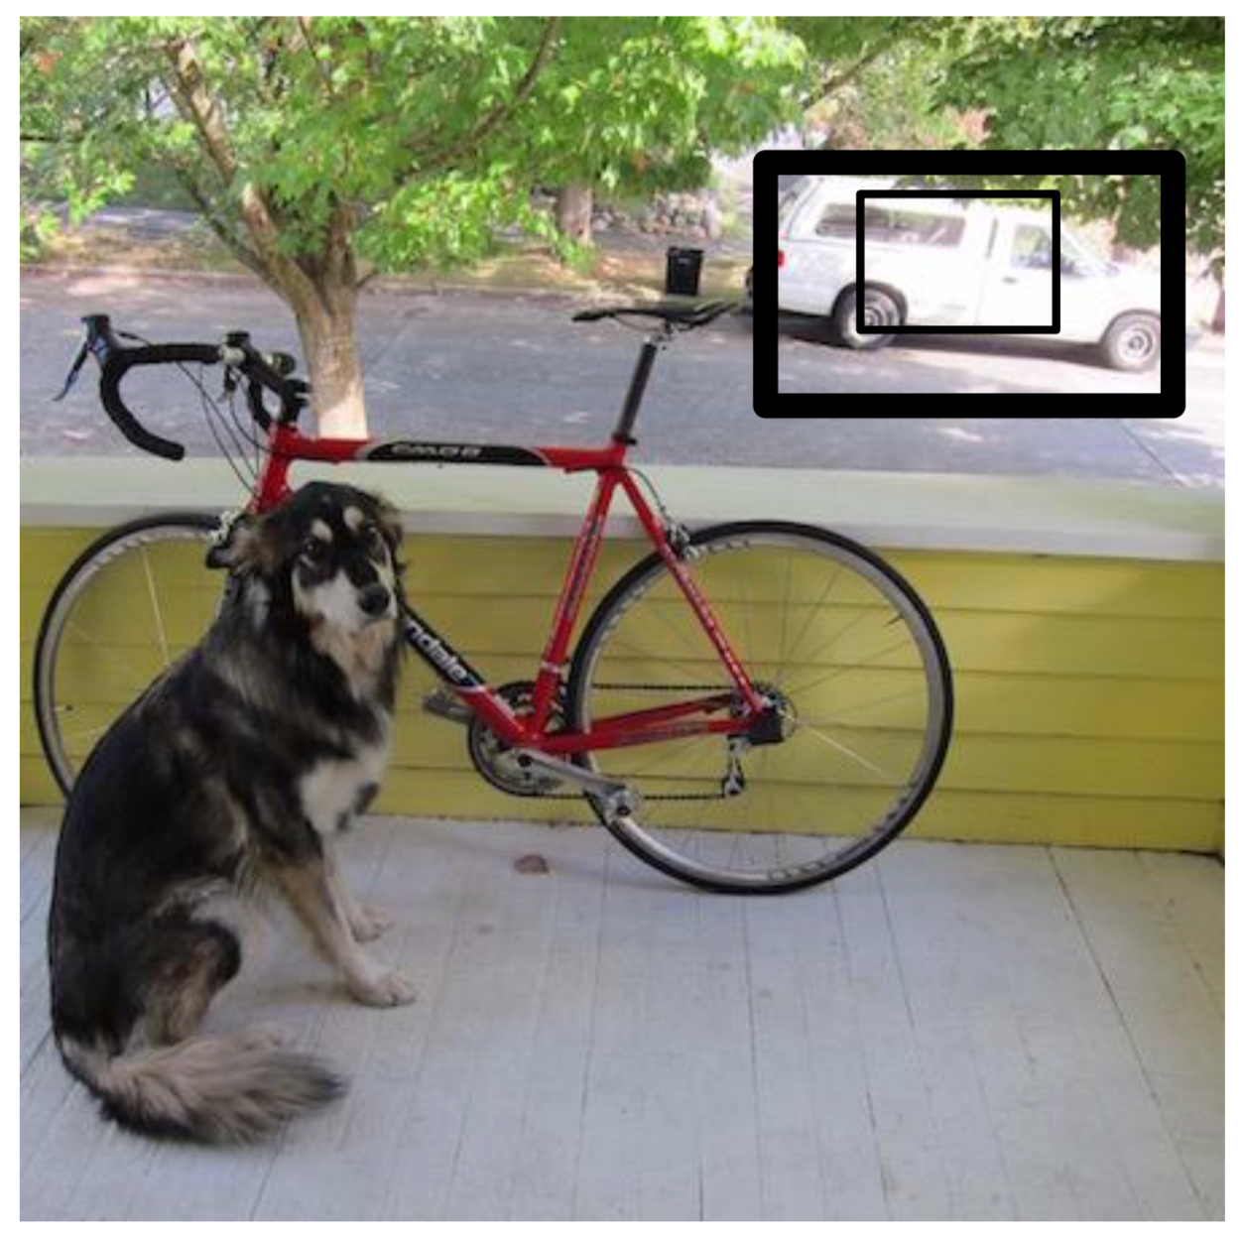
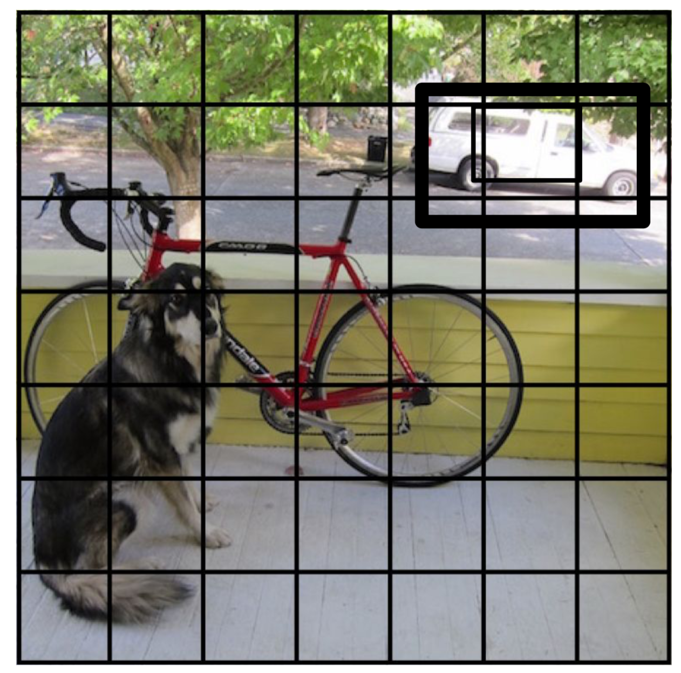
YOLO v1: You Only Look Once

Slide 2

YOLO v1: You Only Look Once

Slide 3
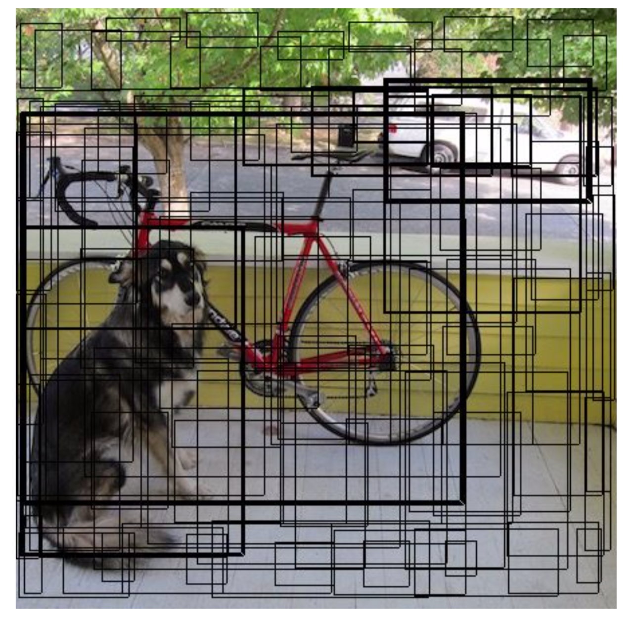
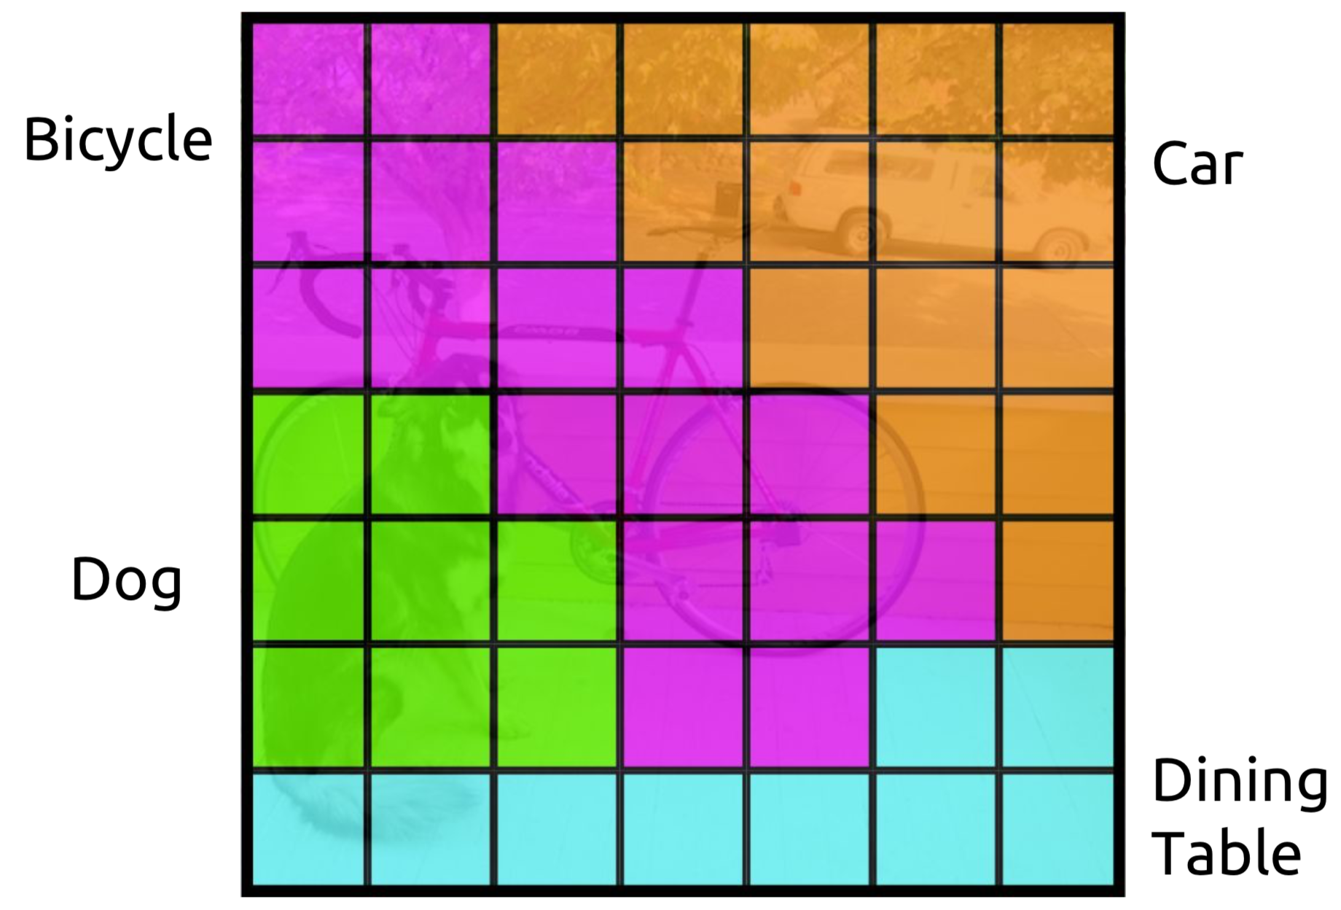
YOLO v1: You Only Look Once

Slide 4
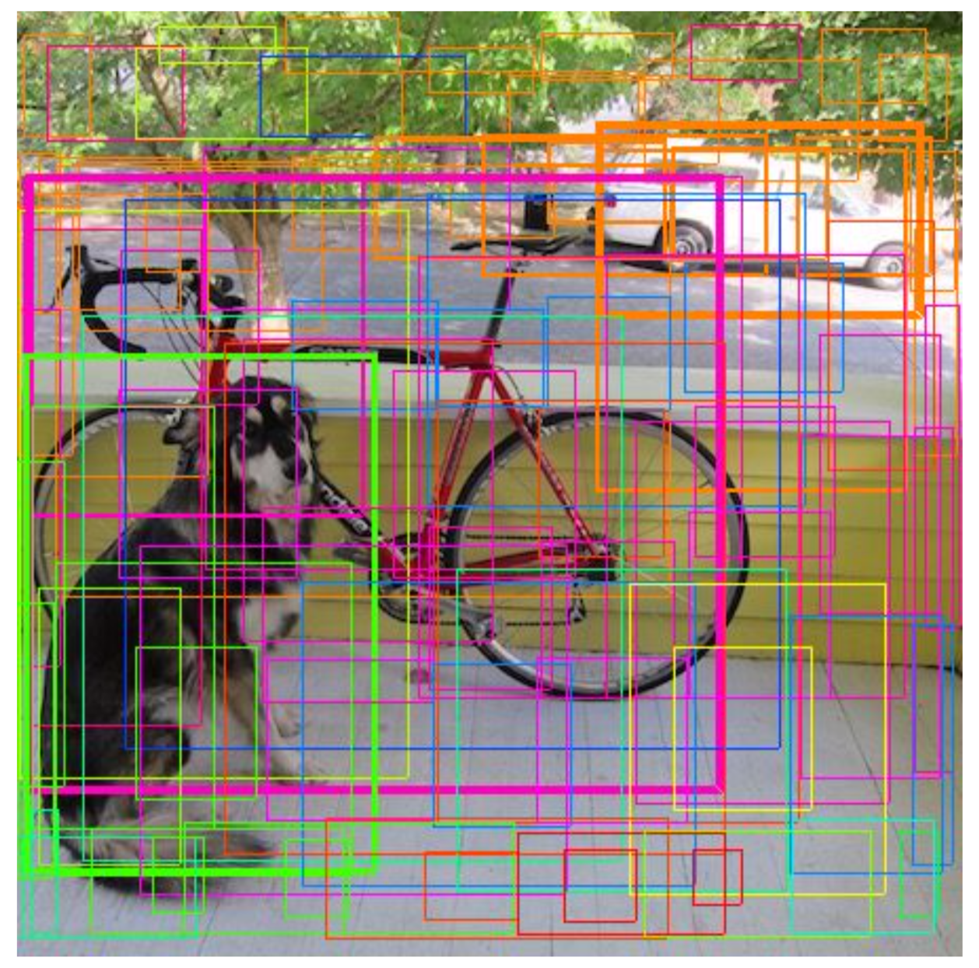
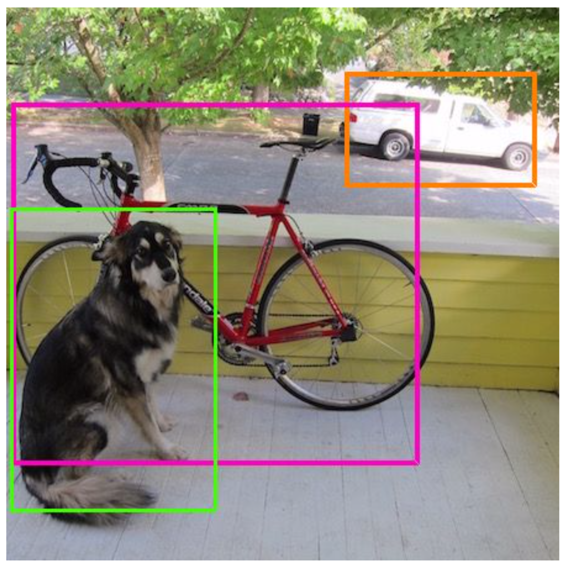
YOLO v1: You Only Look Once

Slide 5
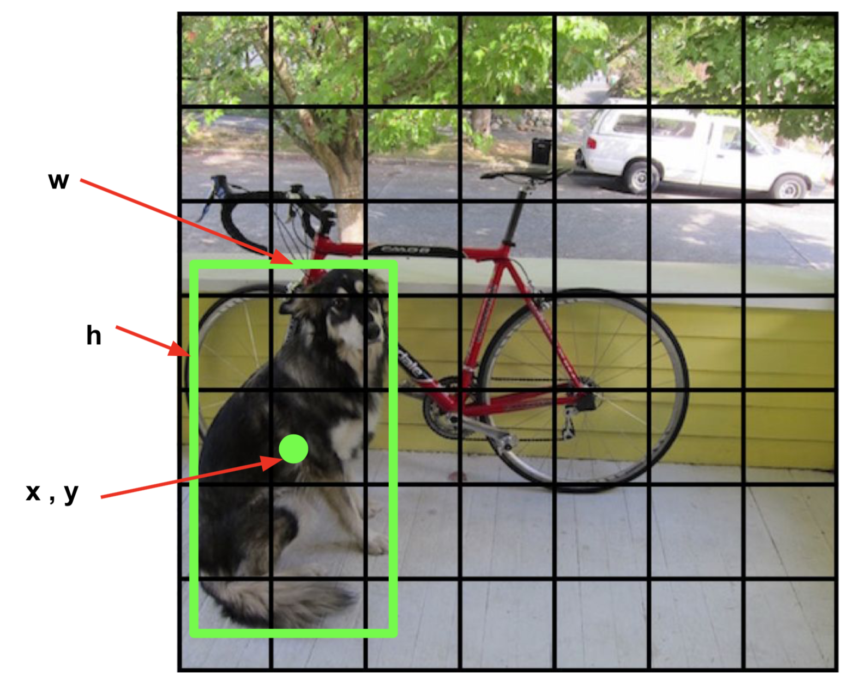
YOLO v1: You Only Look Once

Slide 6
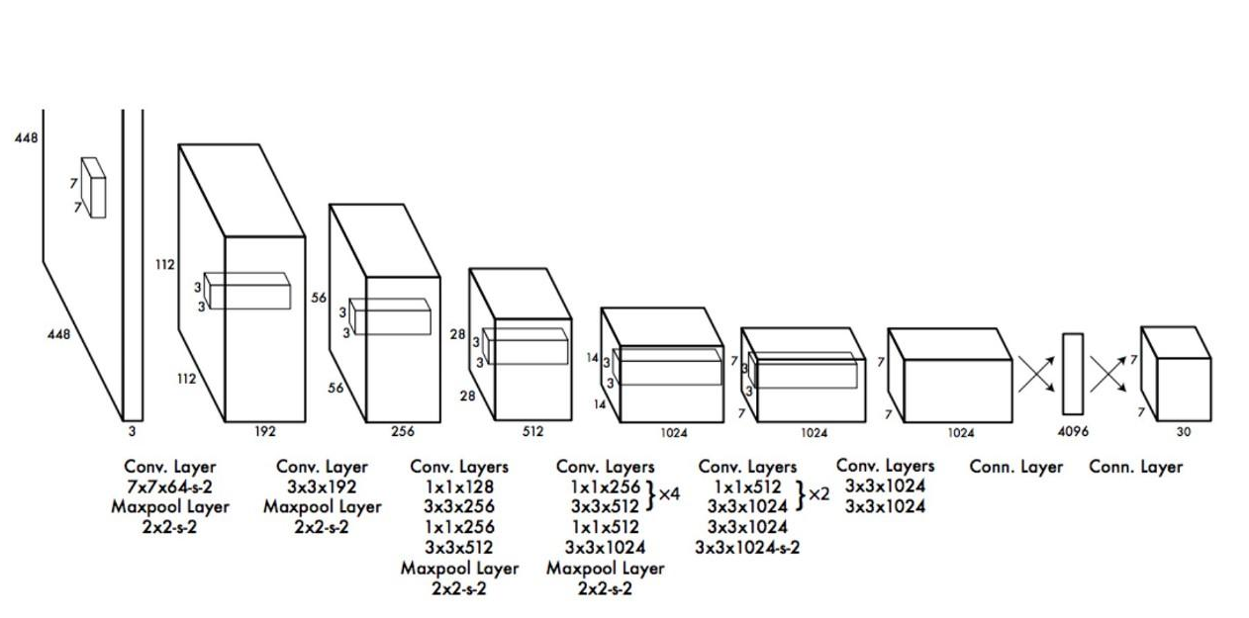
YOLO v1: You Only Look Once

Slide 7
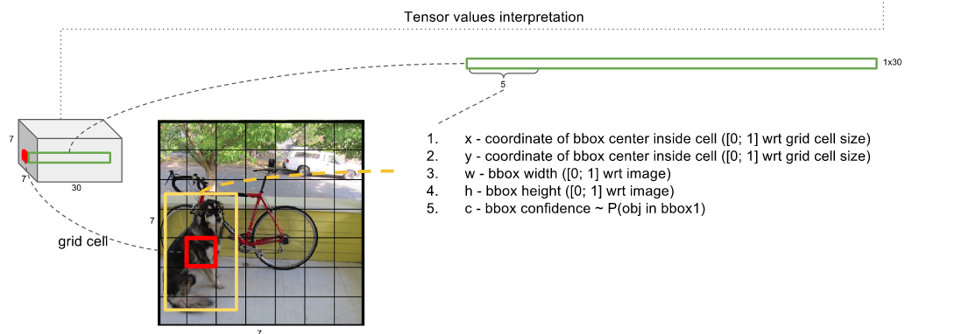
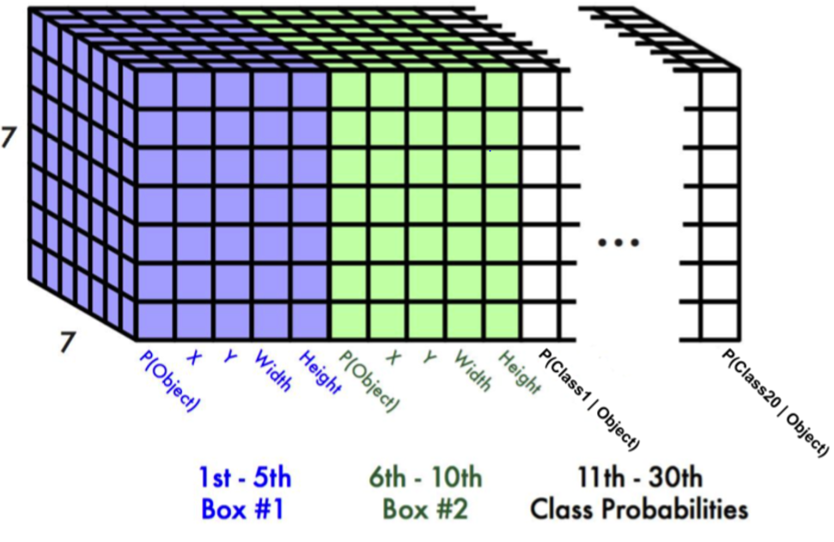
YOLO v1: You Only Look Once
VOC Dataset

Slide 8
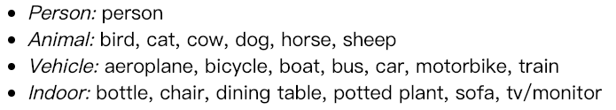
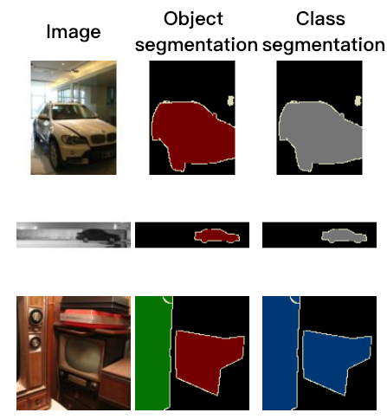
PASCAL VOC Dataset
20 Classes

Slide 9
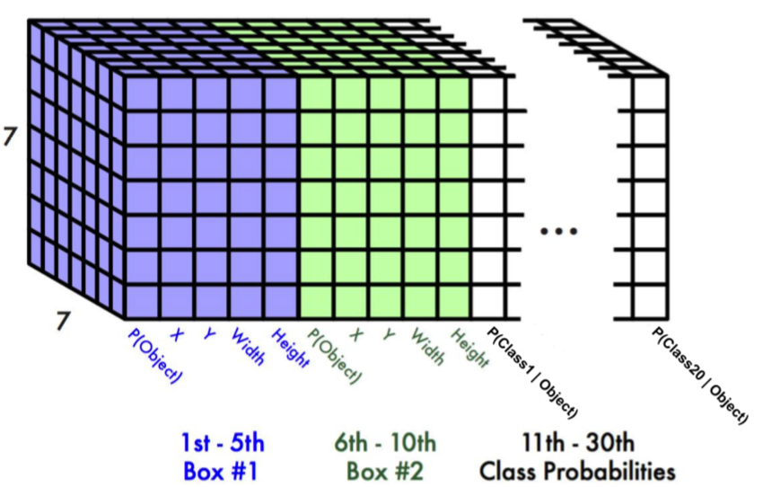
YOLO v1 Output
7x7x30 (20classes + 2*(w,h ,x, y, confidence))
1 grid predicts 2 box and 1 class

Slide 10
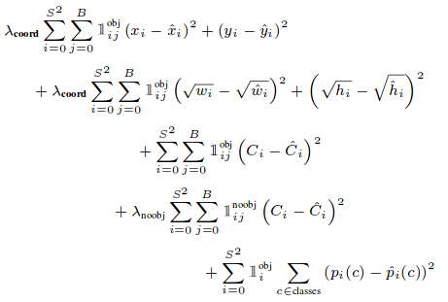
Yolo Loss Function

Slide 11
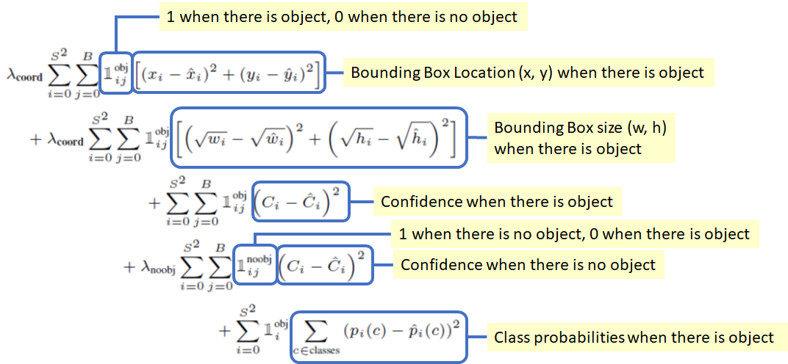
Yolo Loss Function

Slide 12
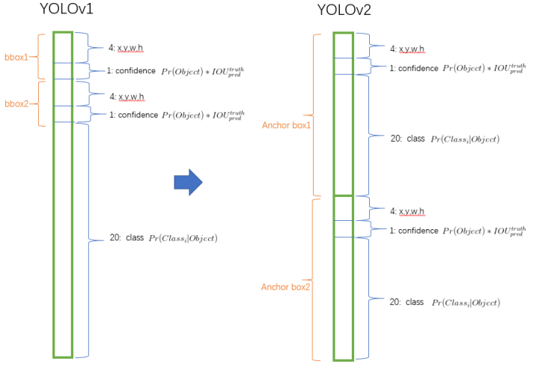
YOLO v2: You Only Look Once
Output: 13 * 13 * (classes + 5) * 5bbox

